Slide 1

Nature’s Fresh Mart
Sponsored by: The British College

Slide 2
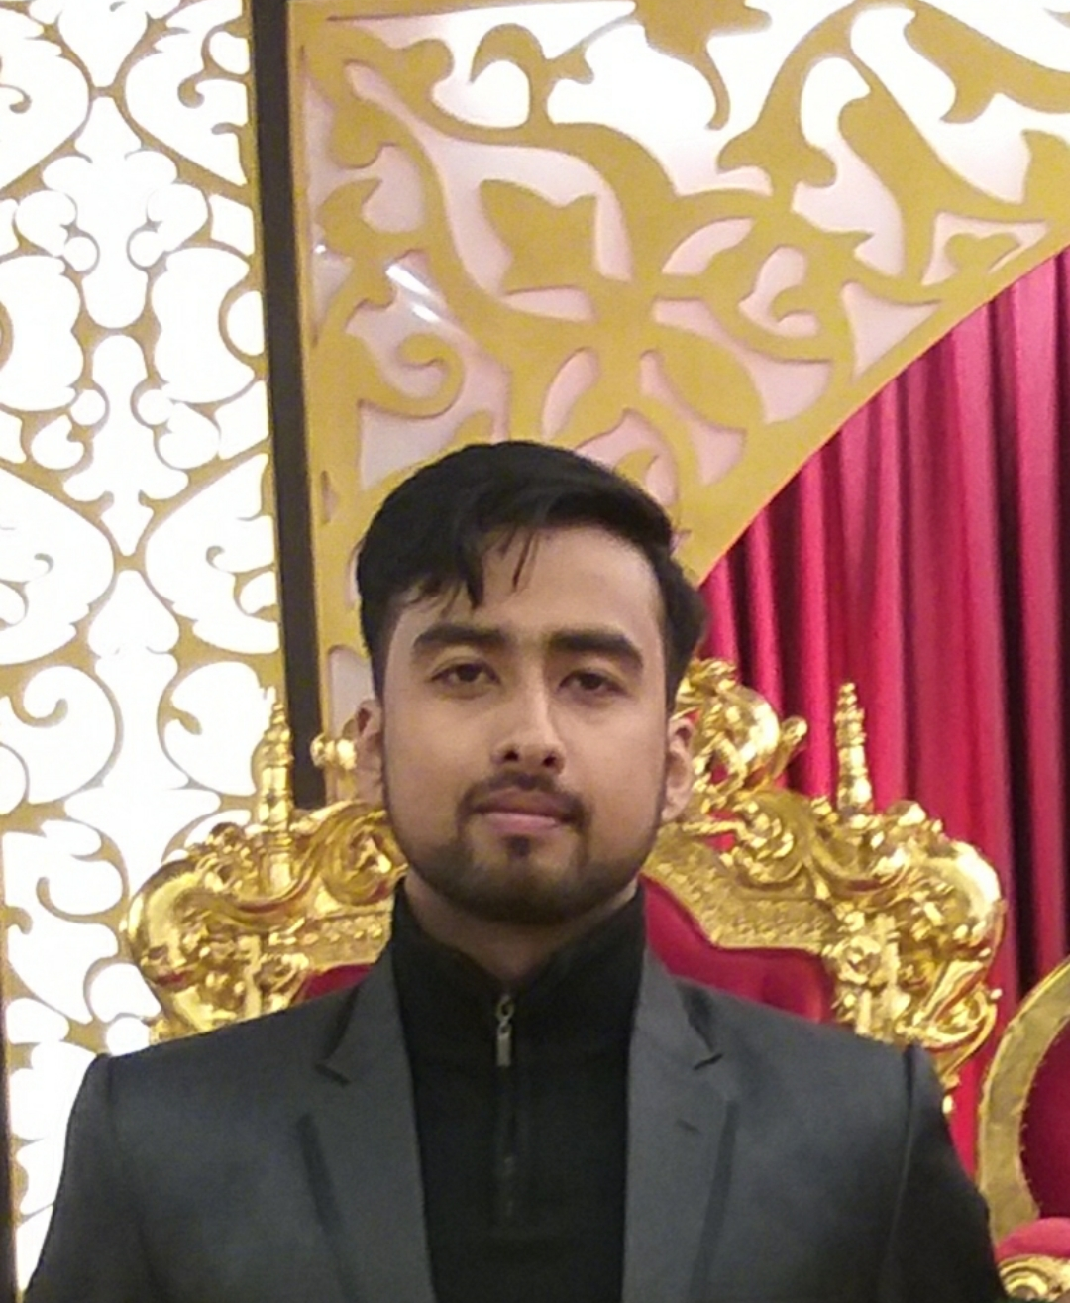
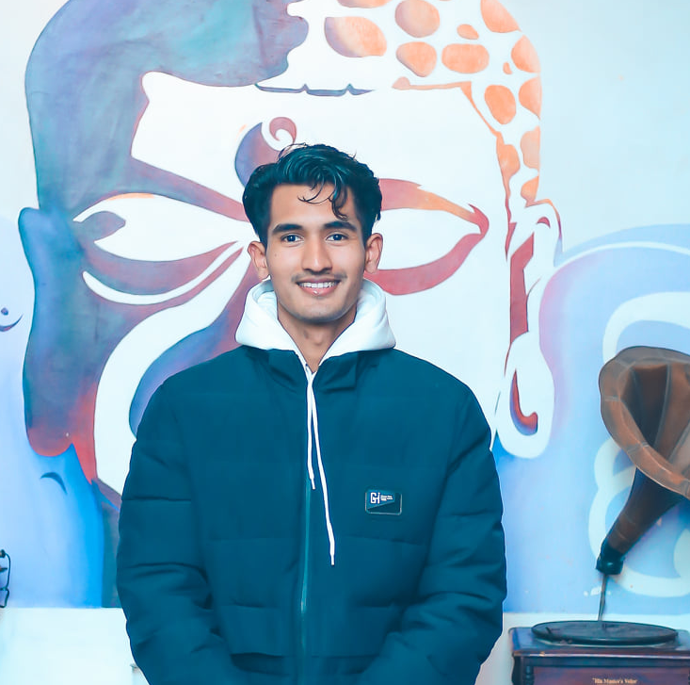


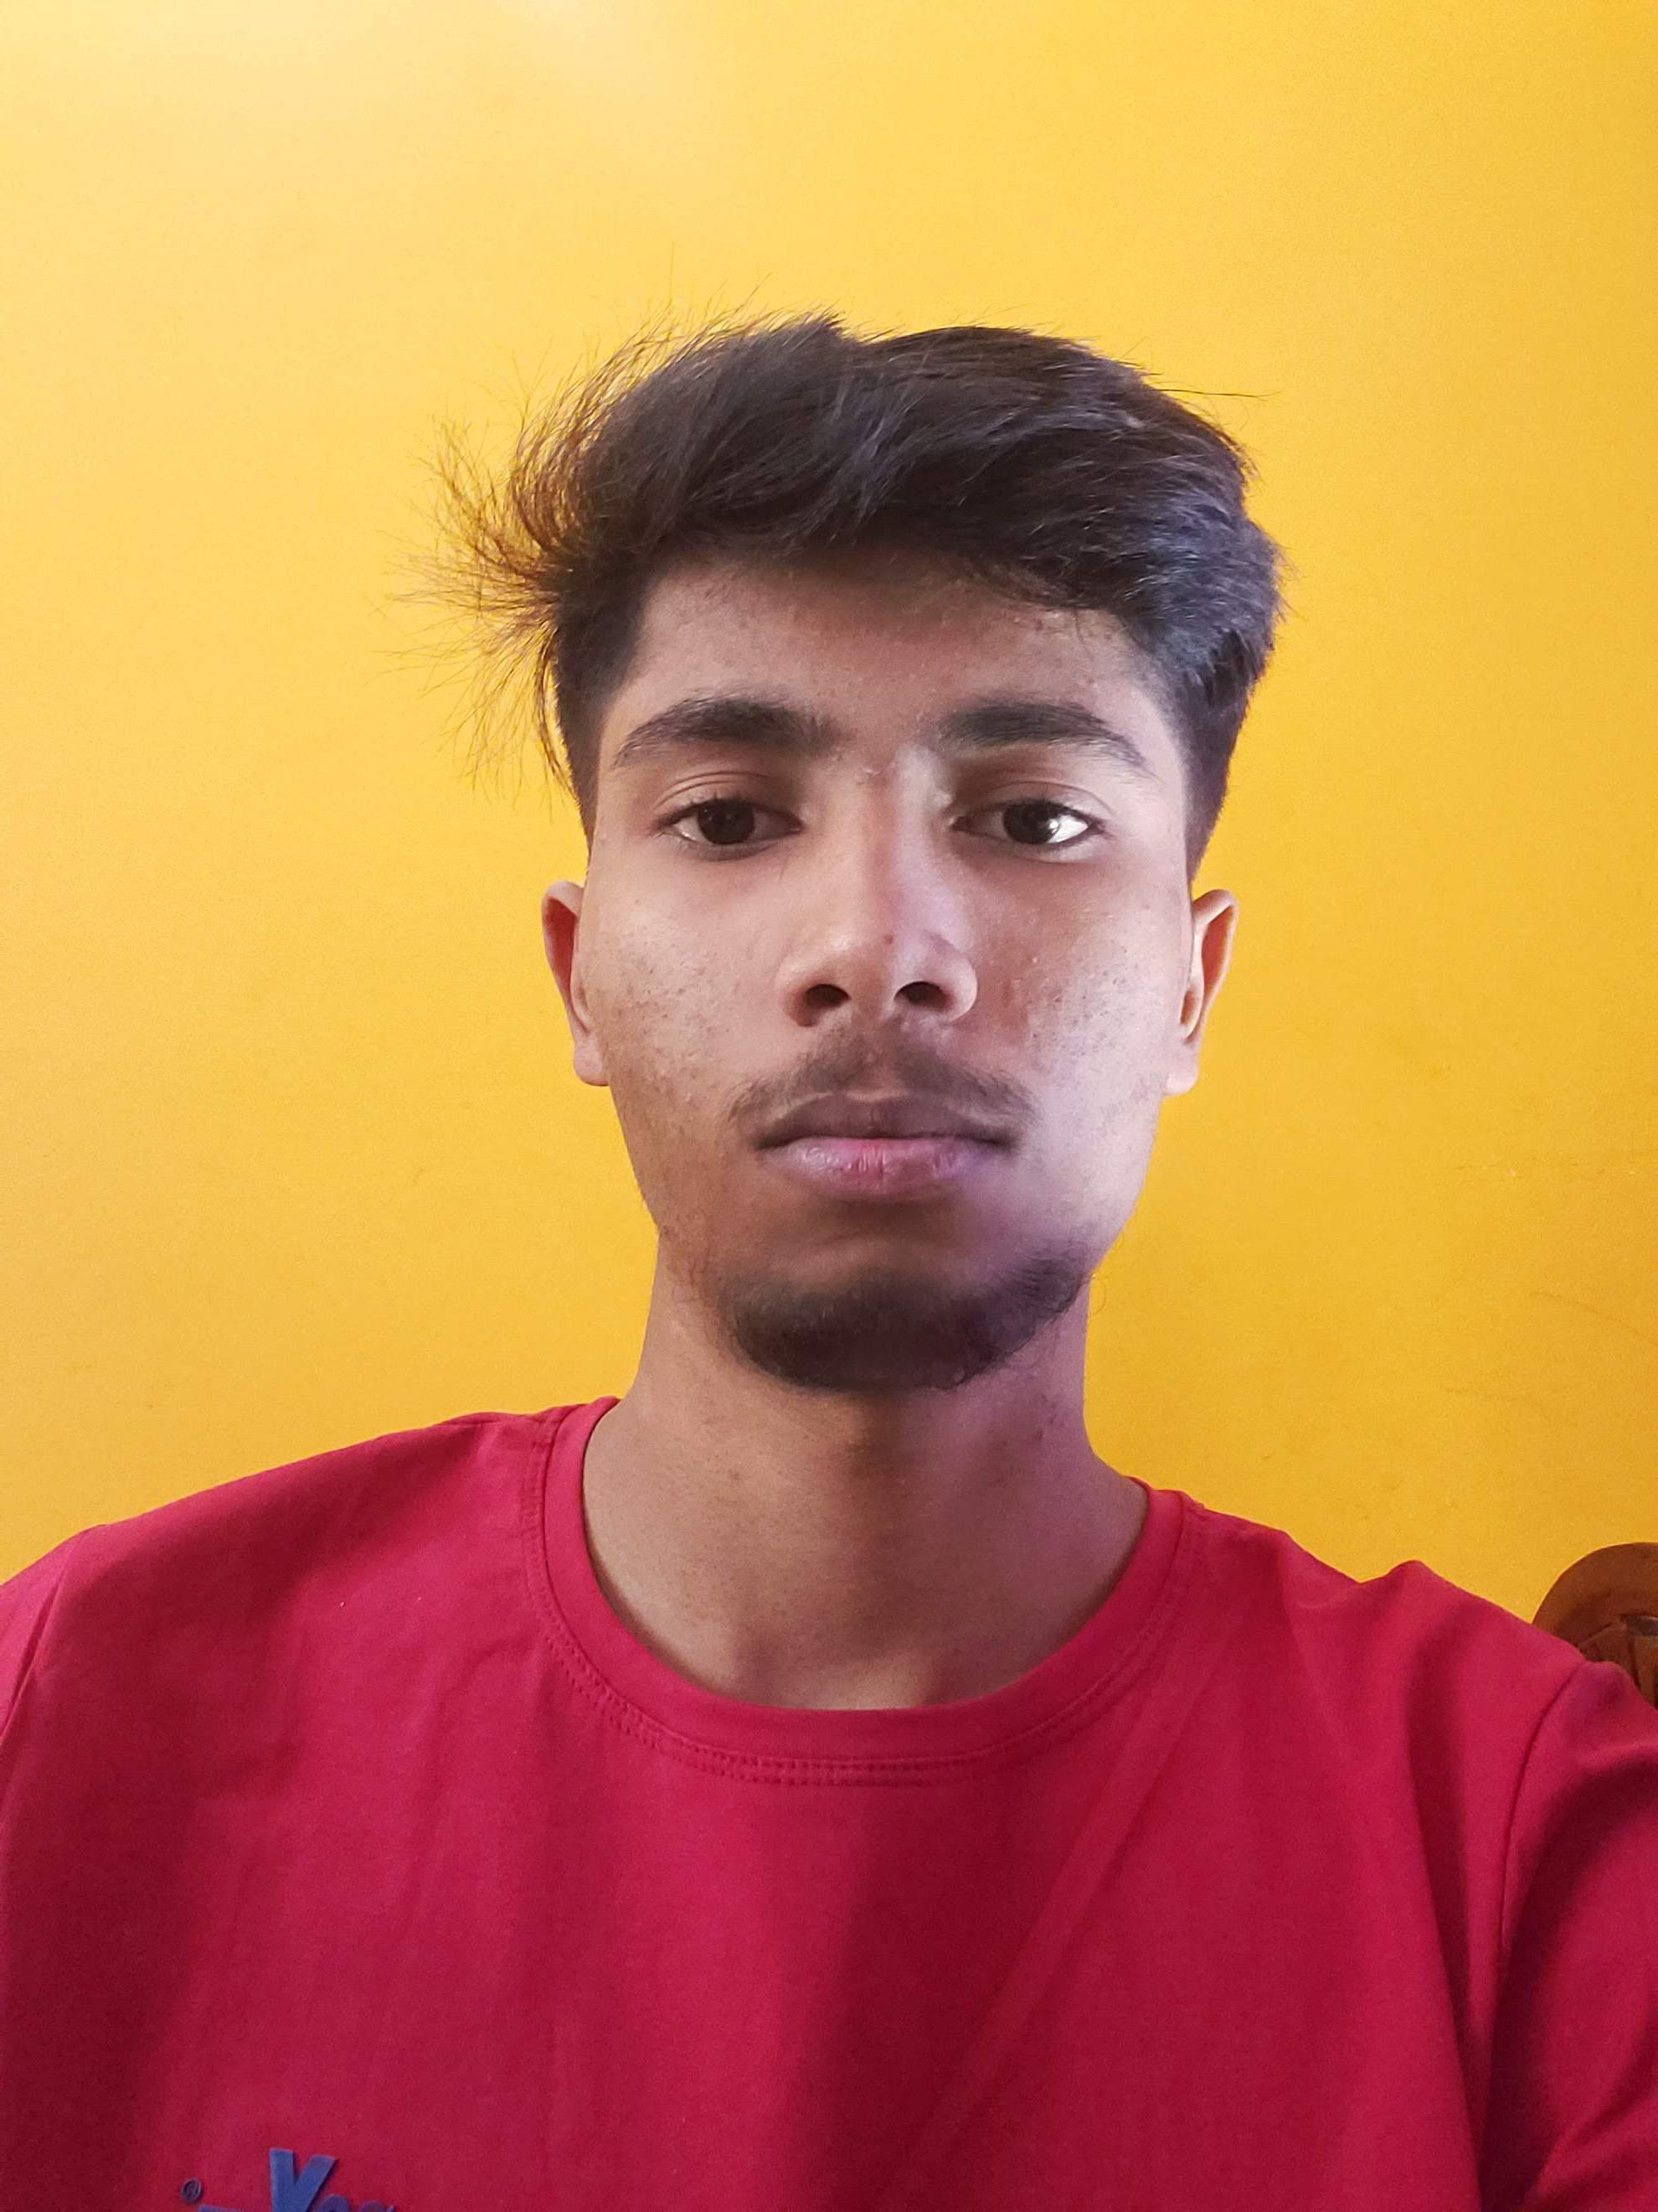
Team Presentation
Saugat Thapa
Co-Ordinator
Plant
Shaper
Rajesh Basnet
Specialist
Complete Finisher
Resource Investigator
Gaurav Bhansali
Shaper
Team Worker
Plant
Harsh Gupta
Team Worker
Monitor Evaluator
Complete Finisher
Aakash Das
Specialist
Complete Finisher
Resource Investigator

Slide 3
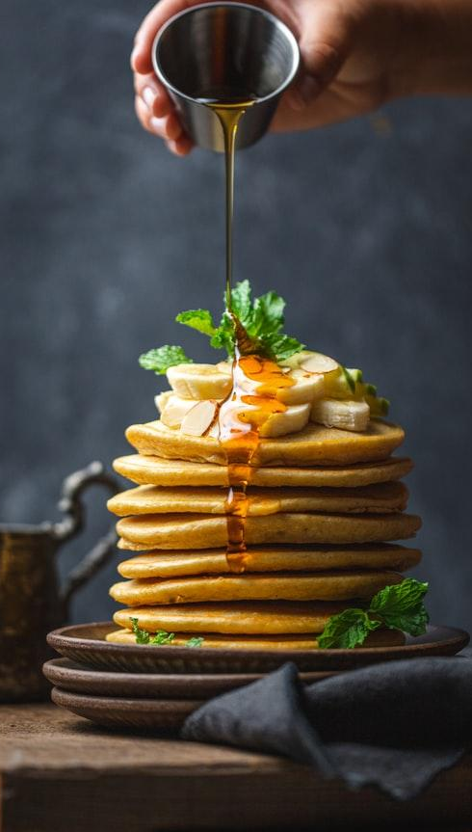
Contents
Project Charter
Belbin Analysis
ERD
EERD
Final Composite EERD
Use Cases
MS-PROJECT
Website Demonstration

Slide 4
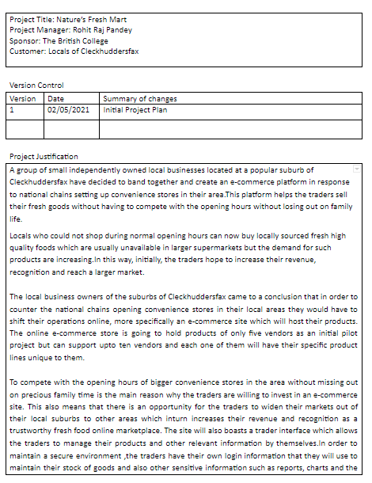
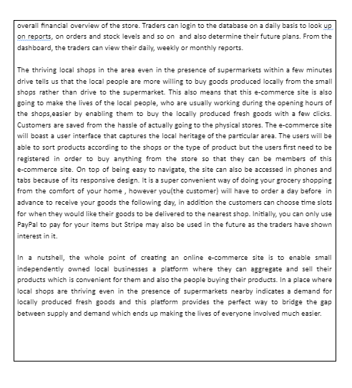
Project
Charter

Slide 5
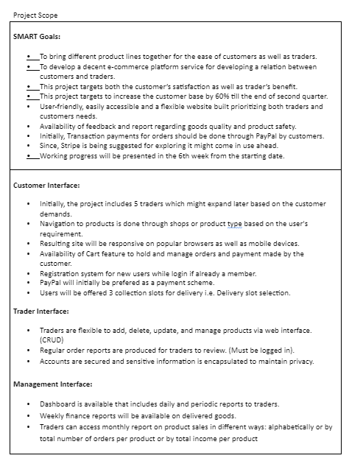
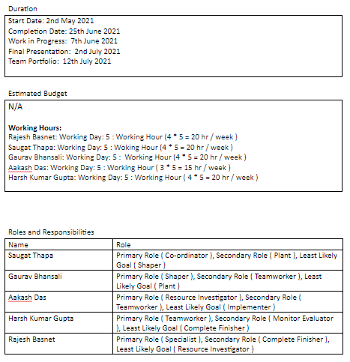
Project
Charter

Slide 6
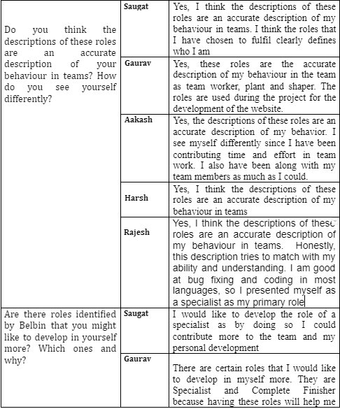
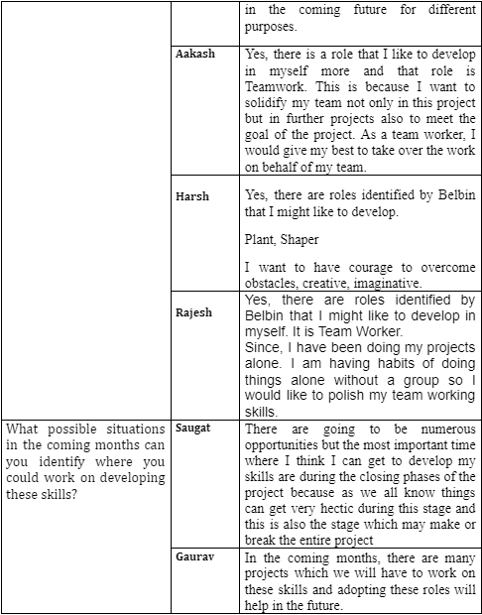
Belbin
Analysis

Slide 7
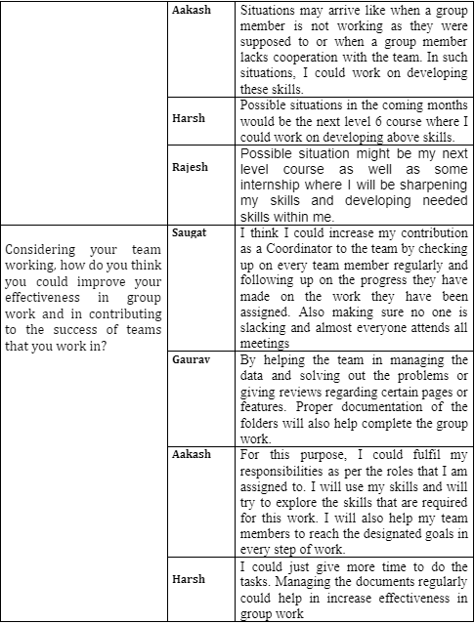
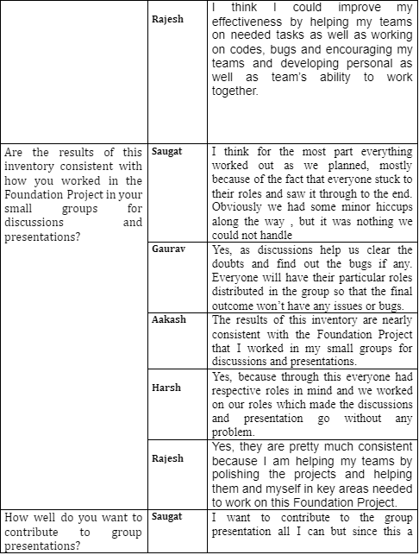
Belbin
Analysis

Slide 8
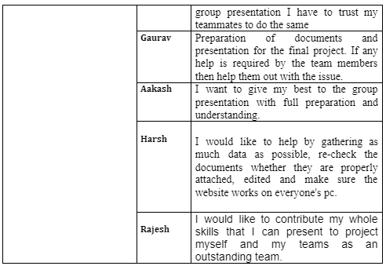
Belbin
Analysis

Slide 9
ERD

Slide 10
EERD

Slide 11
Composite EERD

Slide 12
Overall Use Case

Slide 13
Customer
Use
Case

Slide 14
Trader
Use
Case

Slide 15
Admin
Use
Case

Slide 16
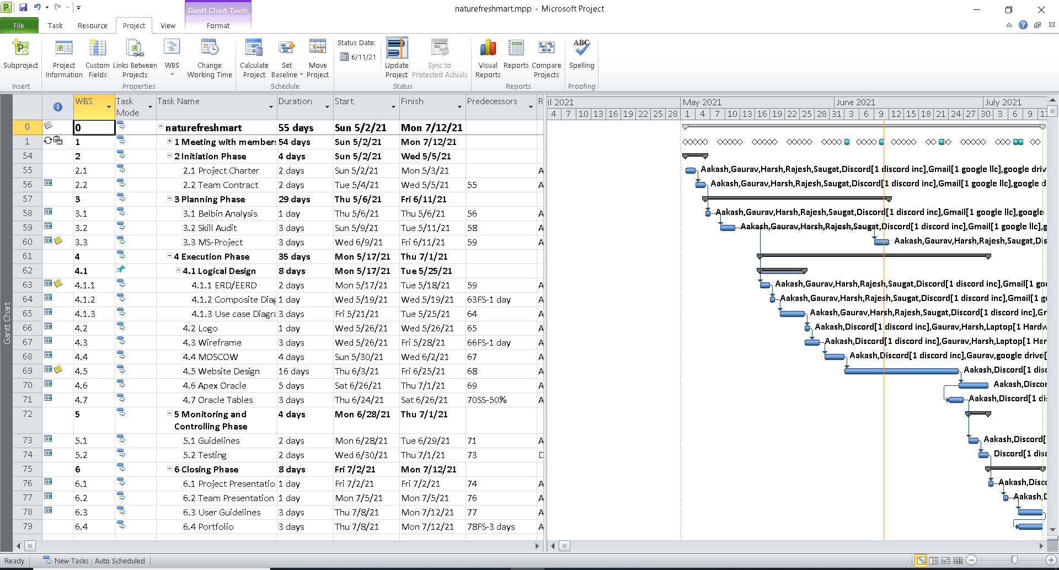
Gantt chart

Slide 17
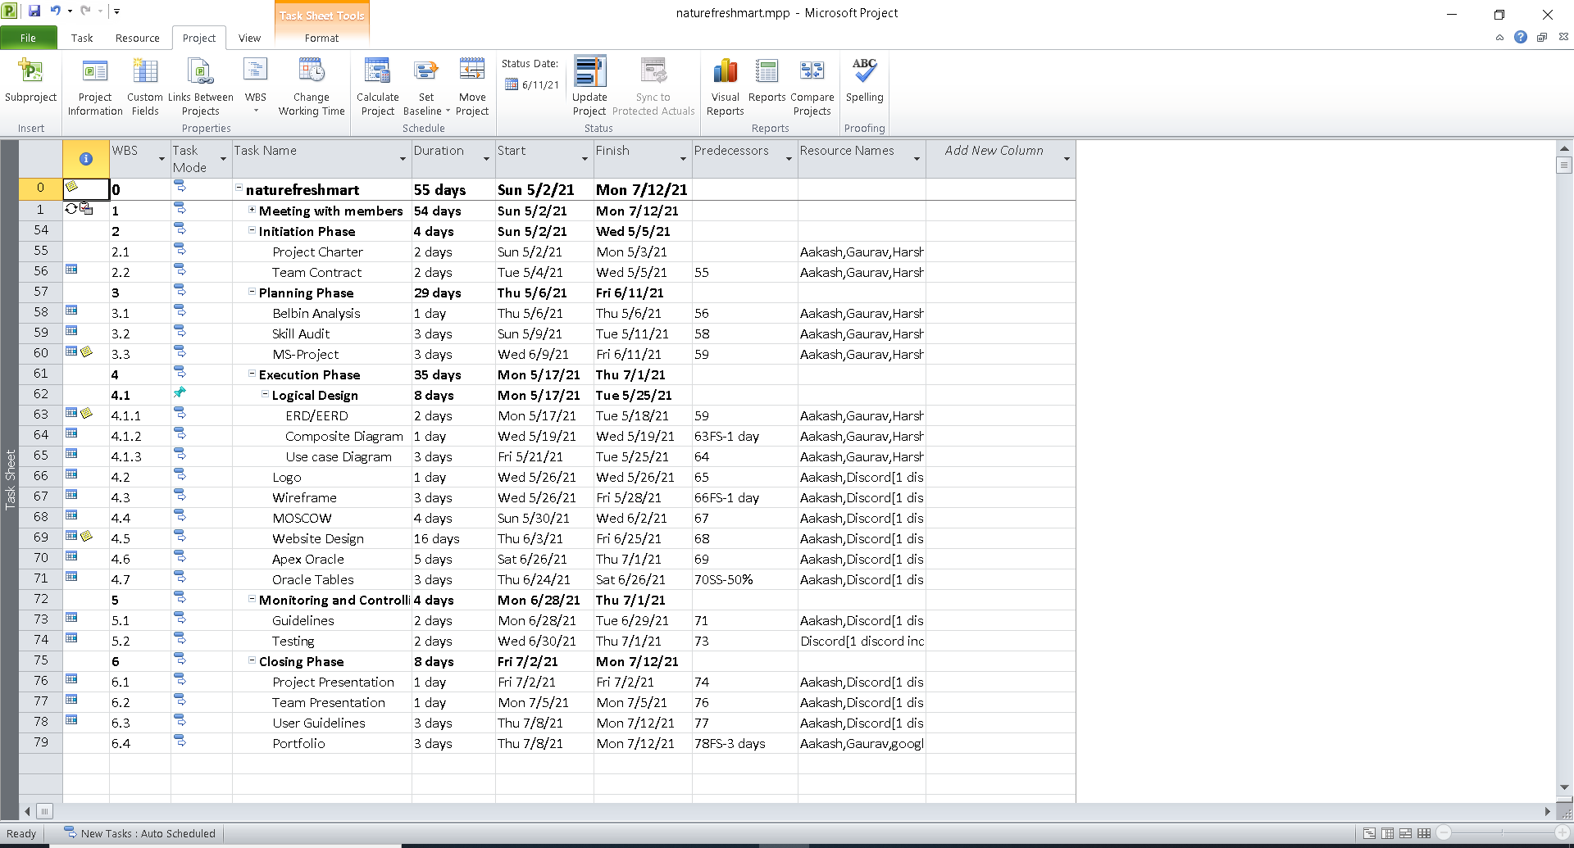
Task Sheet

Slide 18
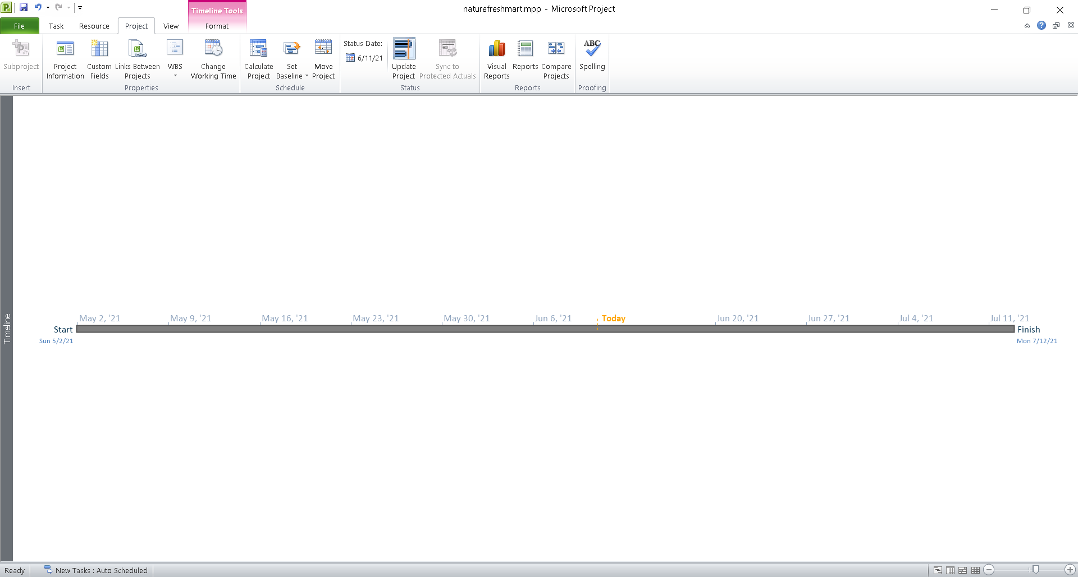
Timeline

Slide 19
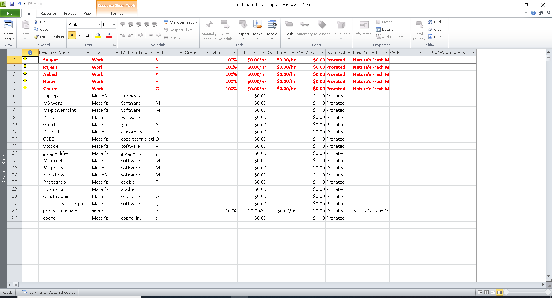
Resource Sheet

Slide 20
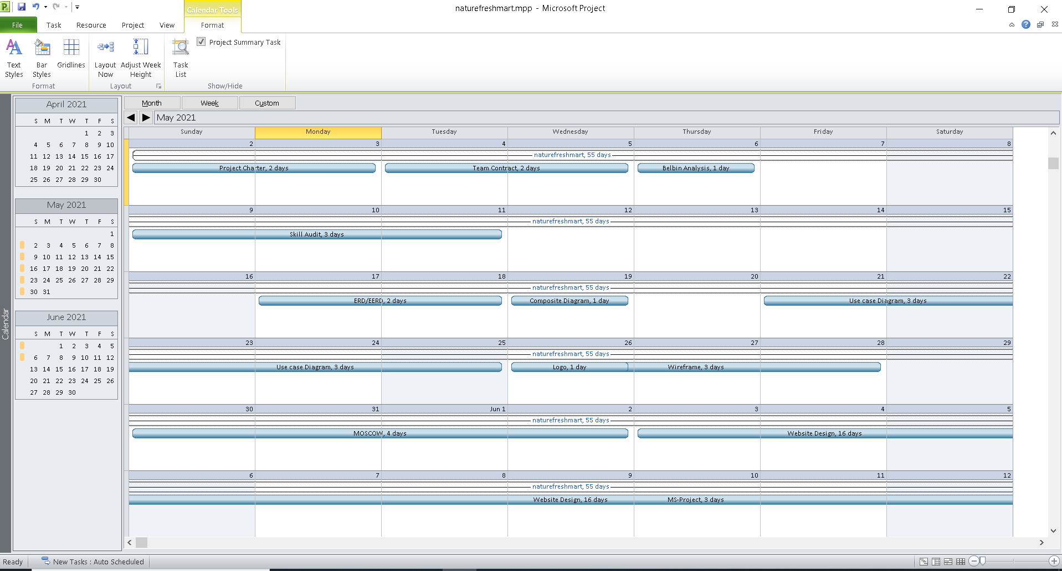
Calendar

Slide 21
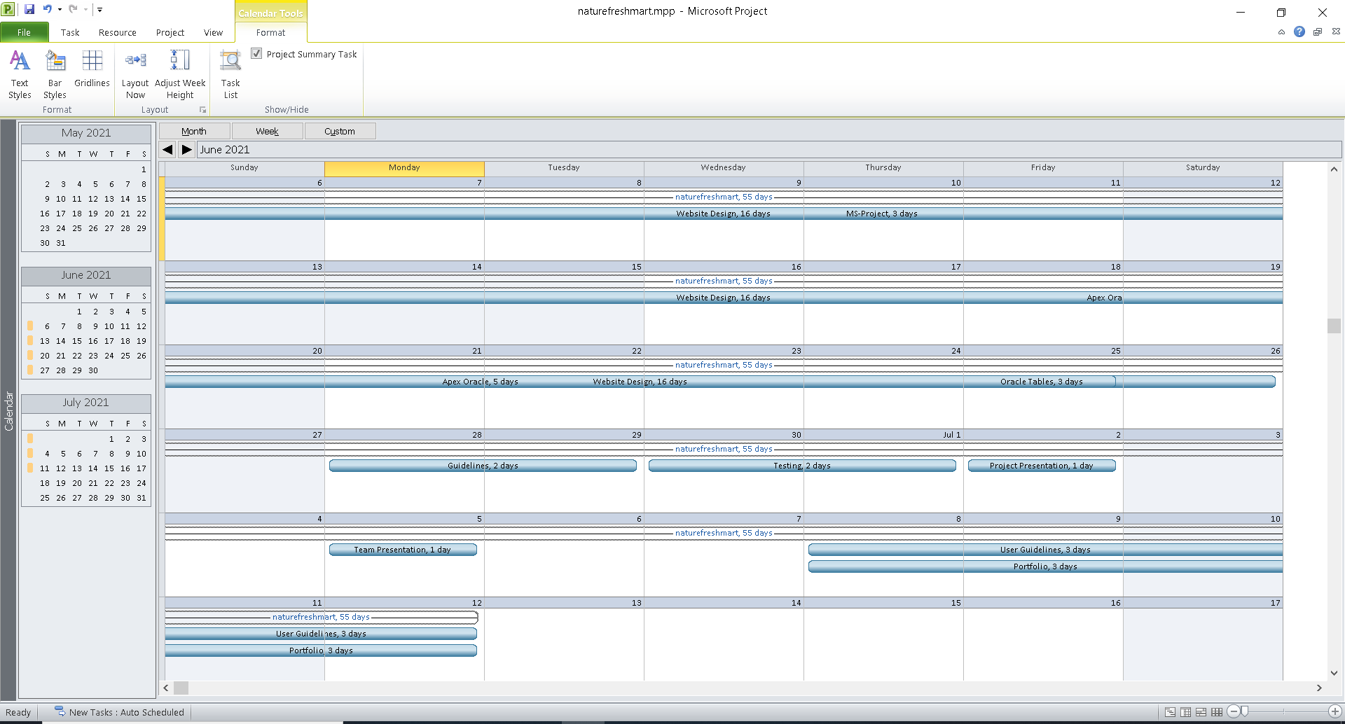
Calendar

Slide 22
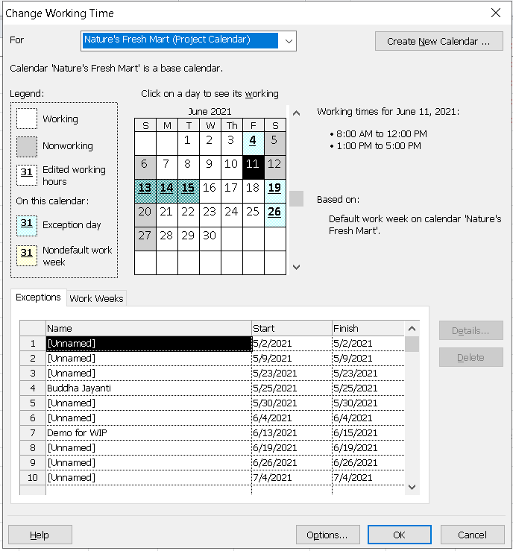
Change in Working Time

Slide 23
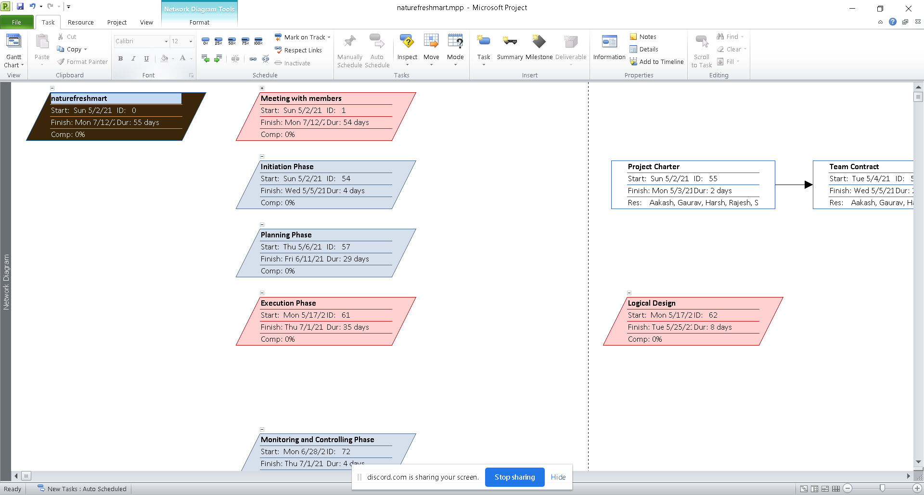
Network Diagram

Slide 24
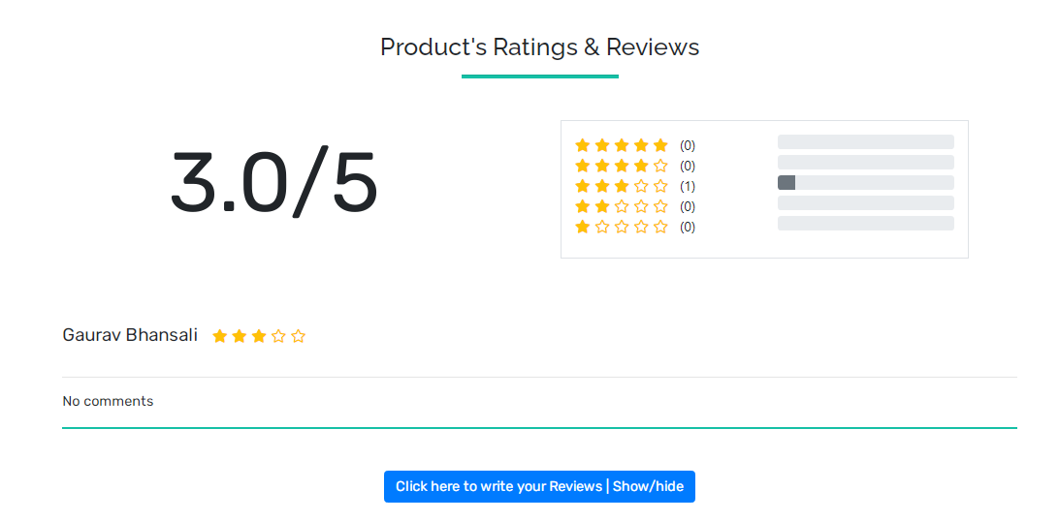
Additional Features (Average Rating)

Slide 25
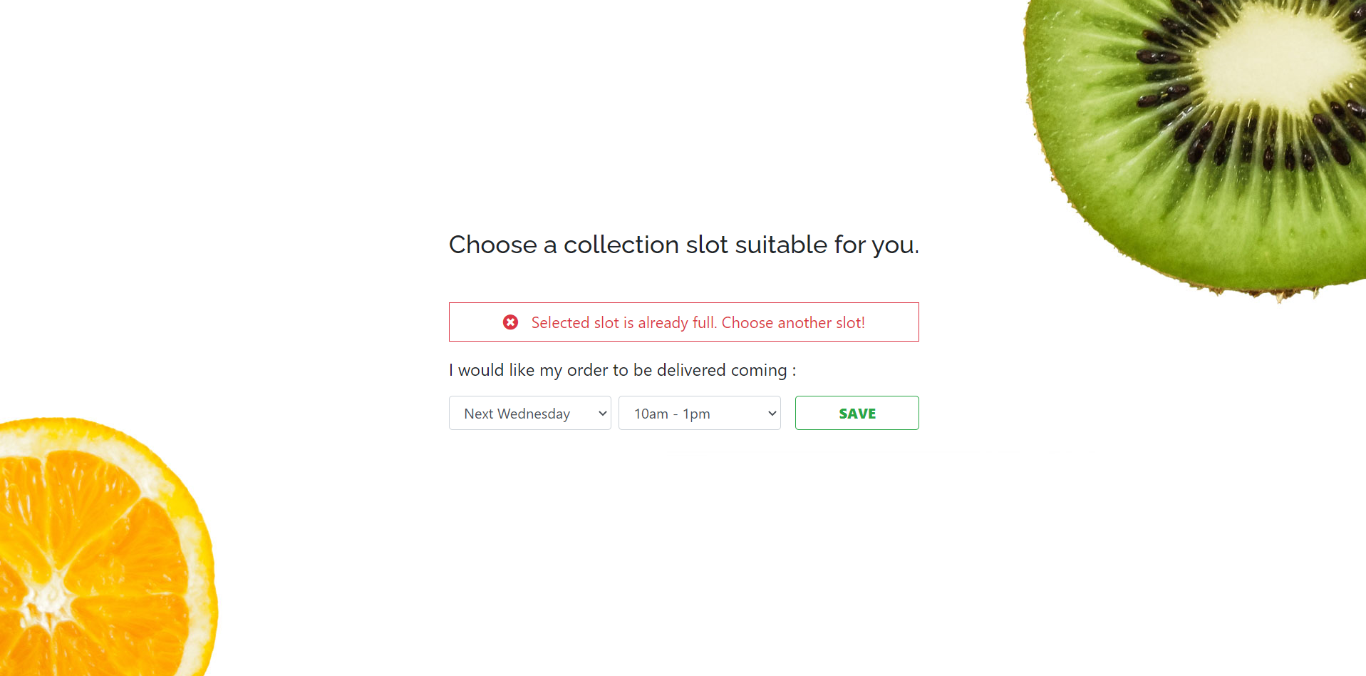
Additional Features (Collection Slot)

Slide 26
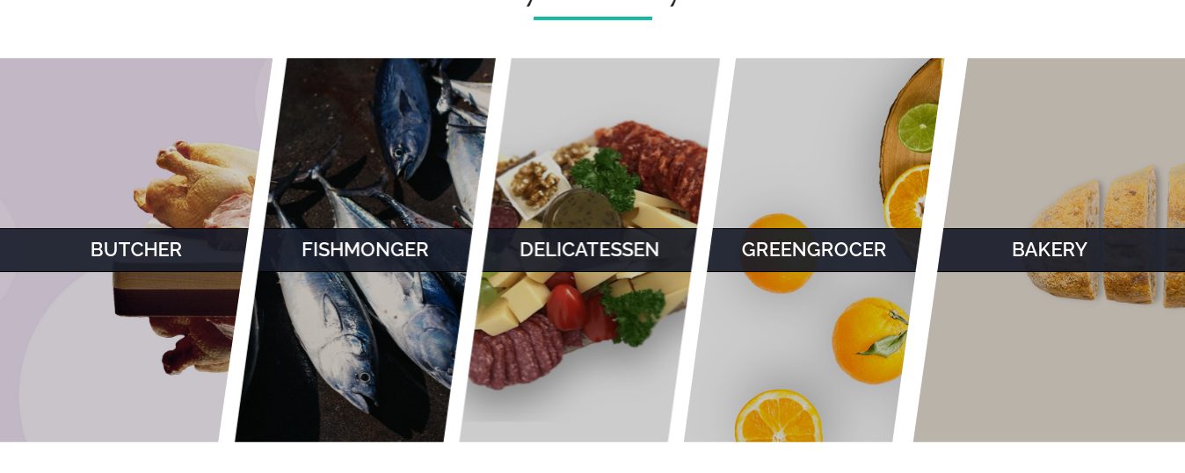
Additional Features (Avenger Style)

Slide 27
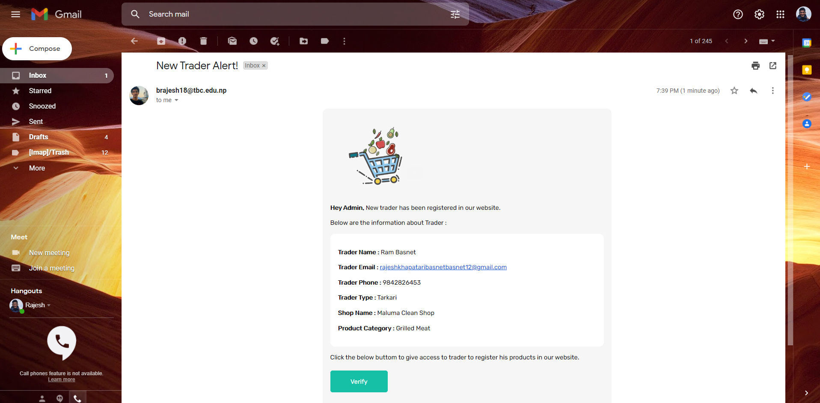
Additional Features (Trader verfication)

Slide 28
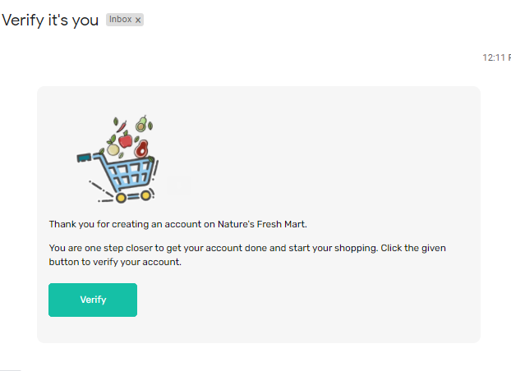
Additional Features (Customer verfication)

Slide 29
Now, we would like to proceed to the website demostration with all the features included in our project.

